Slide 1

Identification of critical connectors in the directed reaction-centric graphs of microbial metabolic networks
Individual Analysis
Laura Shub

Slide 2
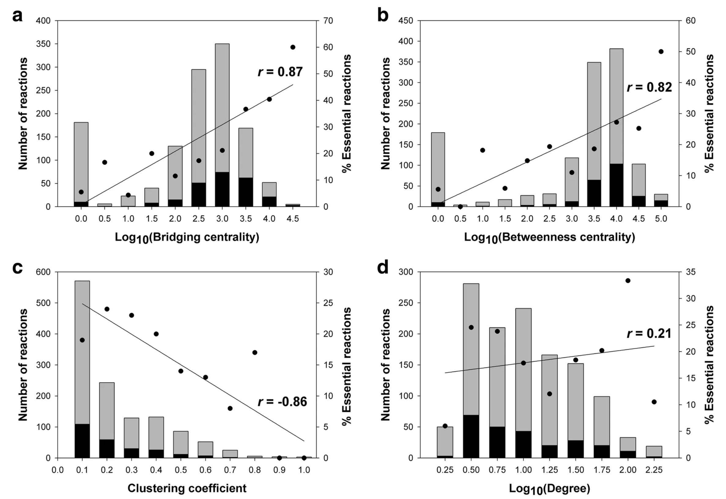
Kim et. al, 2019
Betweenness centrality
Bridging coefficient
Bridging centrality
Clustering coefficient
Cascade number

Slide 3
How robust are these correlations to changes in graph topology?

Slide 4
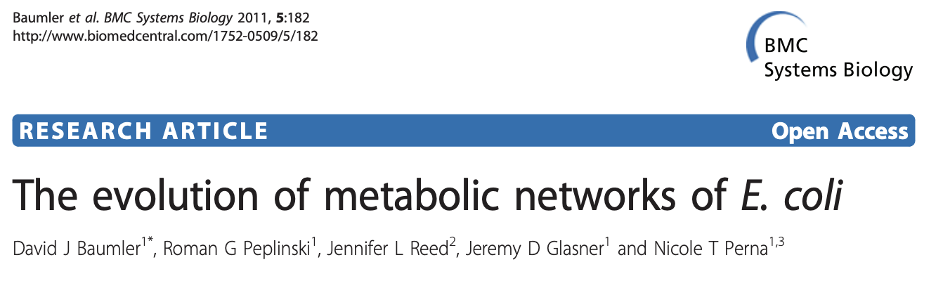
E. coli metabolic models
MG1655
W3110
EDL933
SAKAI
CFTO73
UTI89
Core
“The number of essential reactions shared in common for all six E. coli strains and also the E. coli ancestral core in both aerobic and anaerobic growth conditions was determined (n = 280)”

Slide 5
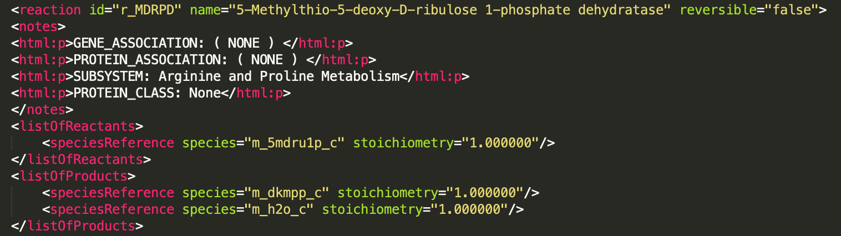
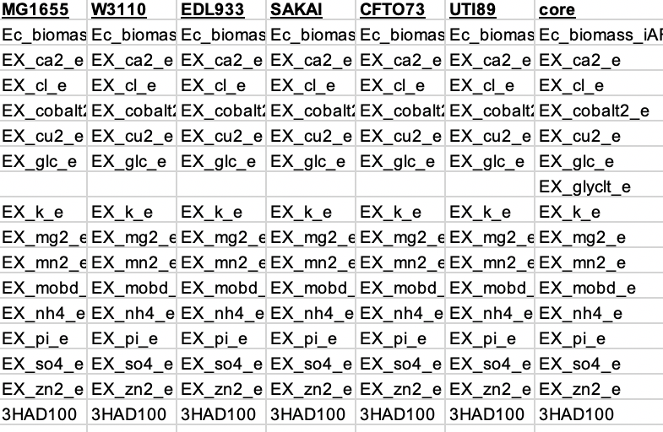
Constructing reaction networks
Read name, products, reactants
Construct arcs
Assign essential/non-essential
Choices
Strip ‘m_’, ‘r_’, ‘_p’
No self-loops
No transport reactions

Slide 6
Reaction graph summary
Strain | Reactions | Arcs | Essential
MG1655 | 1579 | 250,771 | 213
W3110 | 1578 | 250,758 | 213
EDL933 | 1549 | 244,641 | 215
SAKAI | 1546 | 243,903 | 215
CFTO73 | 1526 | 234,055 | 213
UTI189 | 1532 | 236,822 | 213
core | 1432 | 203,777 | 214

Slide 7
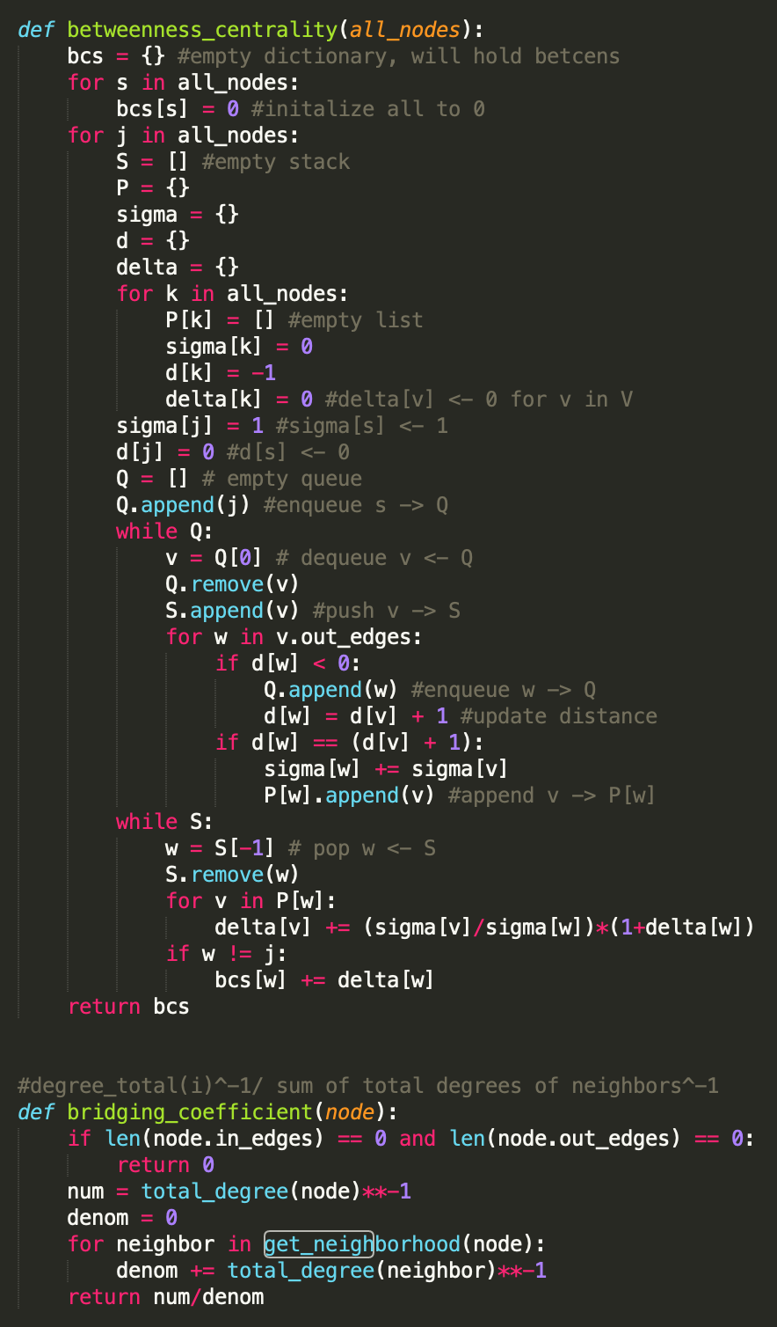
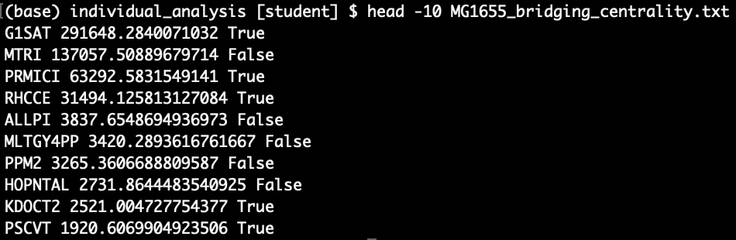
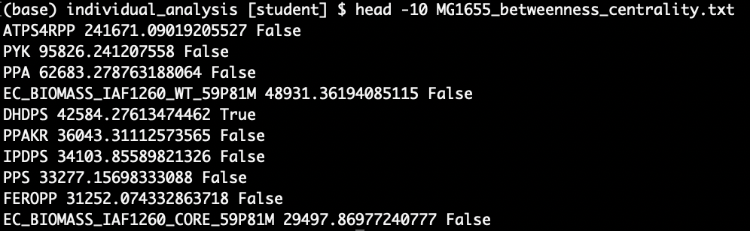
Calculating centrality metrics

Slide 8
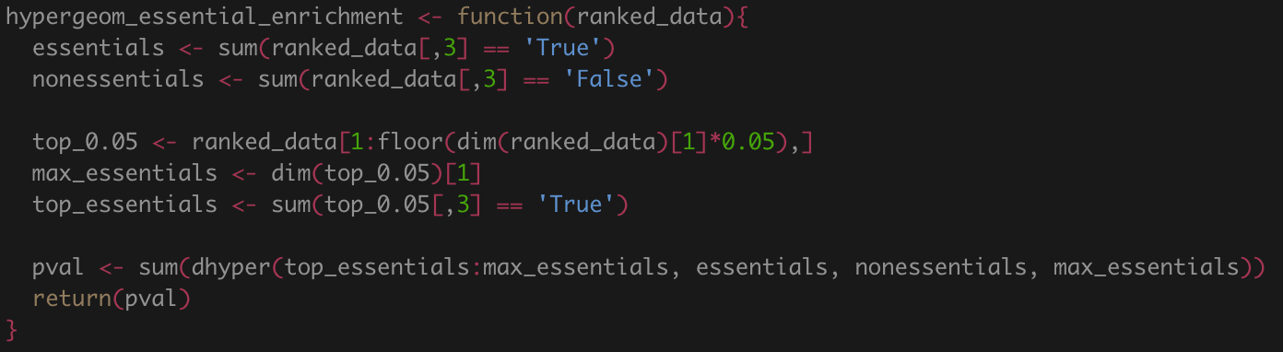
Calculating enrichment – essential reactions
Hypergeometric test for enrichment

Slide 9
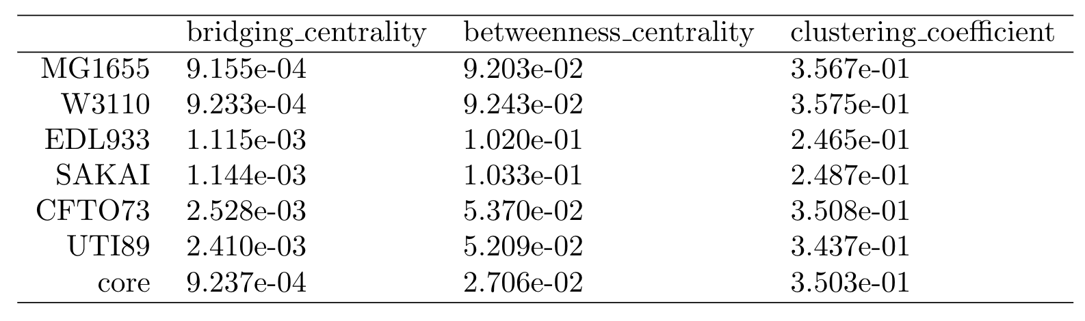
Calculating enrichment – essential reactions
“…29 [essential reactions] were ranked in the top 5% of high bridging centralities (P-value = 1.52 × 10⁻ ⁷) and 23 were listed in the top 5% of high betweenness centralities (P-value = 2.86 × 10⁻ ⁴).”
Kim, E., Ashlock, D. & Yoon, S. Identification of critical connectors in the directed reaction-centric graphs of microbial metabolic networks. BMC Bioinformatics 20, 328 (2019)

Slide 10
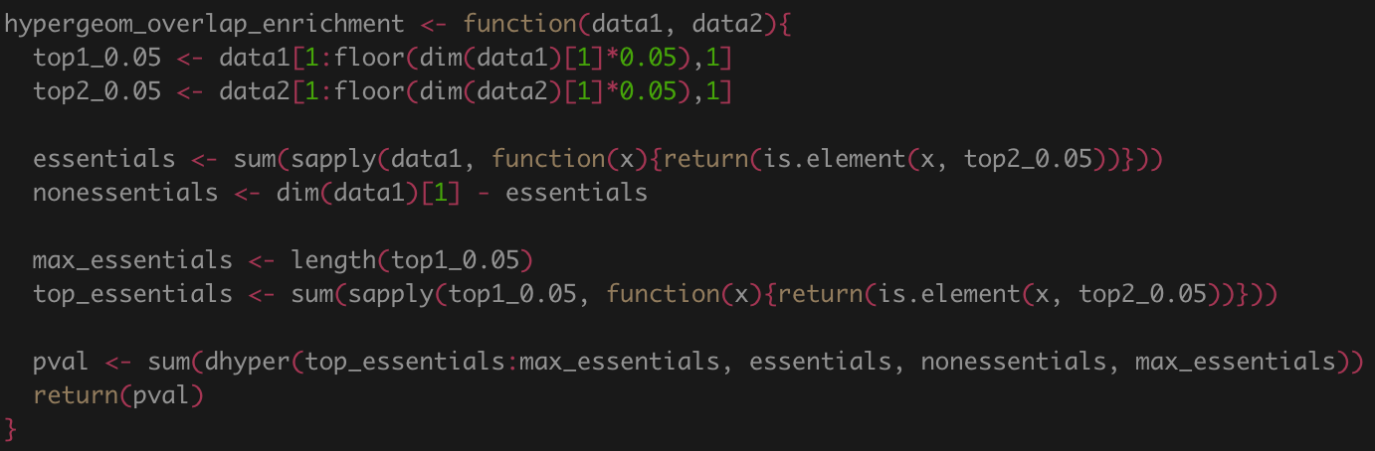
Calculating enrichment – overlap of top reactions

Slide 11
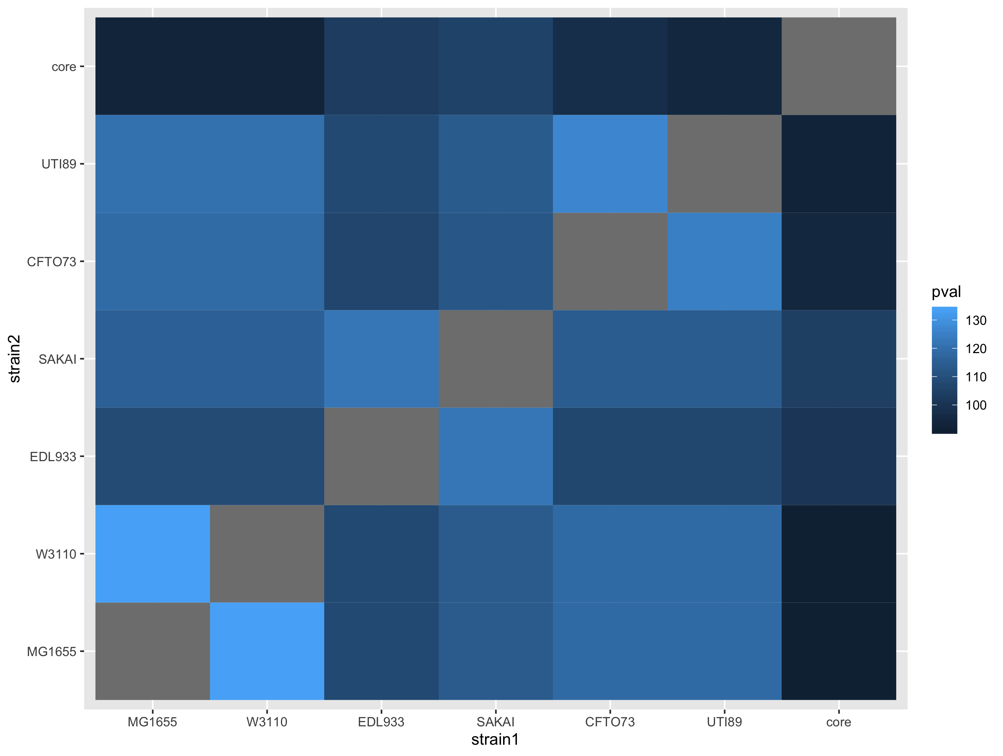
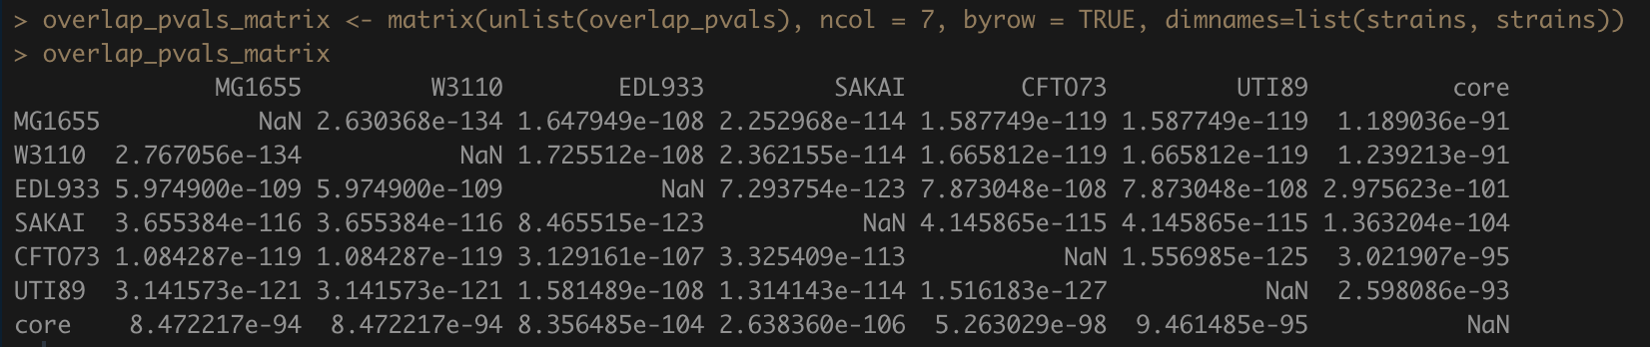
Calculating enrichment – overlap of top reactions by bridging centrality
Bridging centrality is very robust to small changes in graph topology
-log10(p)

Slide 12
Questions?

